Slide 1




SDN-Based Traffic Steering Using Open
vSwitch & Ryu Controller
Programmable, policy-driven network control using Software-Defined Networking principles to enable intelligent, dynamic traffic management in modern enterprise environments.
Presented by Deepith G C
21 Jan 2026
CAPSTONE PROJECT | QUADGEN WIRELESS

Slide 2
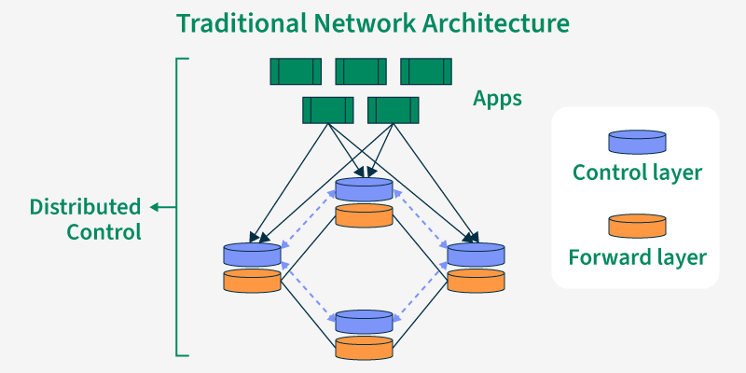



The Challenge: Traditional Networks Hit Their Limits
Traditional Network Limitations
Static routing decisions that can't adapt to changing conditions
Manual configuration required for each network device
Poor visibility into real-time traffic behavior
Slow response to congestion events or network failures
Real-Time Adaptation
Networks must respond instantly to changing traffic patterns and application needs
Industry Demands
Data centers, telecom networks, and modern enterprises require:
Dynamic traffic control and optimization
Application-aware intelligent routing
Centralized visibility and management
Faster failure detection and recovery
Intelligent Path Selection
Traffic steering enables optimal routing based on network conditions and policies
Operational Efficiency
Reduced manual overhead through centralized control
and automation

Slide 3
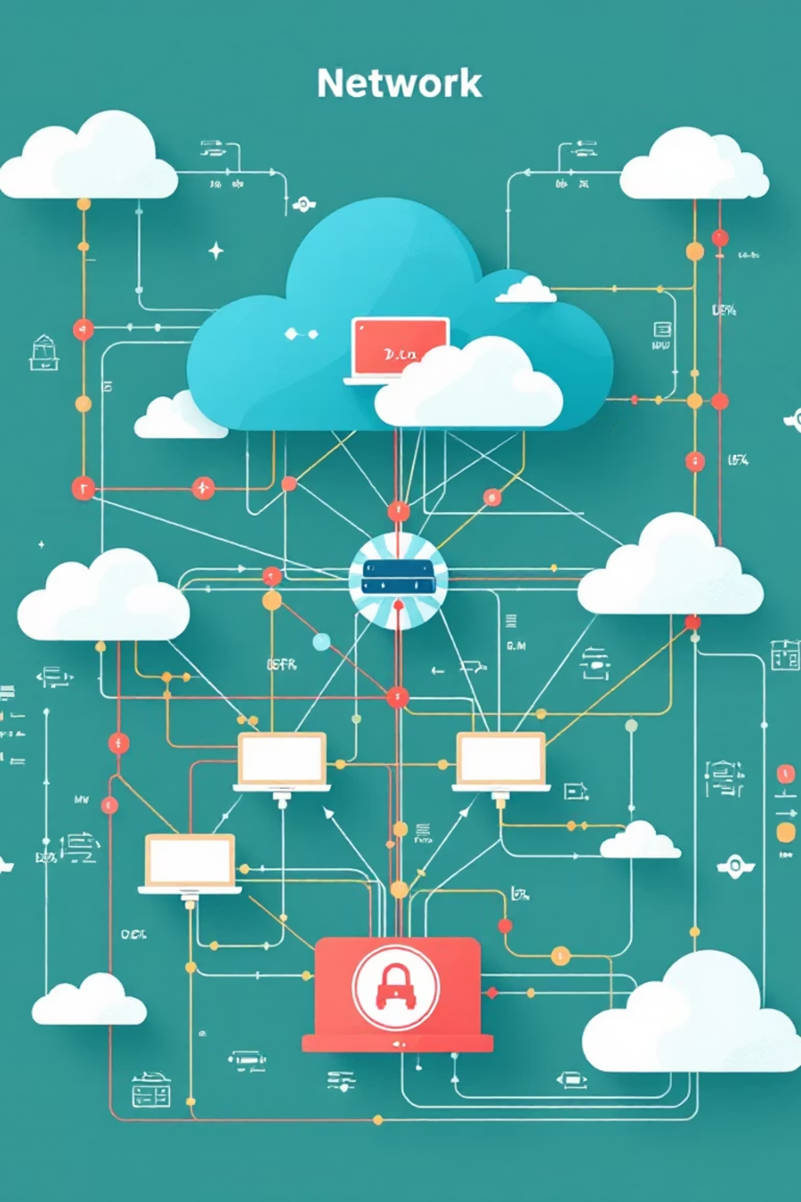



PROBLEM STATEMENT
Defining the Core Challenge
How can network traffic be dynamically routed and optimized based on application requirements and network conditions instead of static forwarding rules?
1
Lack of Centralized Control
Traditional networks distribute decision-making across individual devices, making coordinated optimization nearly impossible
2
Traffic Prioritization Gaps
No effective mechanism exists to prioritize critical business applications over background traffic
3
Inefficient Link Utilization
Static routing often leaves bandwidth underutilized while other paths experience congestion
4
Manual Troubleshooting
Network issues require time-consuming device-by-device investigation and configuration
The SDN Solution
Software-Defined Networking separates the control plane from the data plane, enabling centralized intelligence and implementing traffic steering using OpenFlow protocol for dynamic, policy-driven network management.

Slide 4

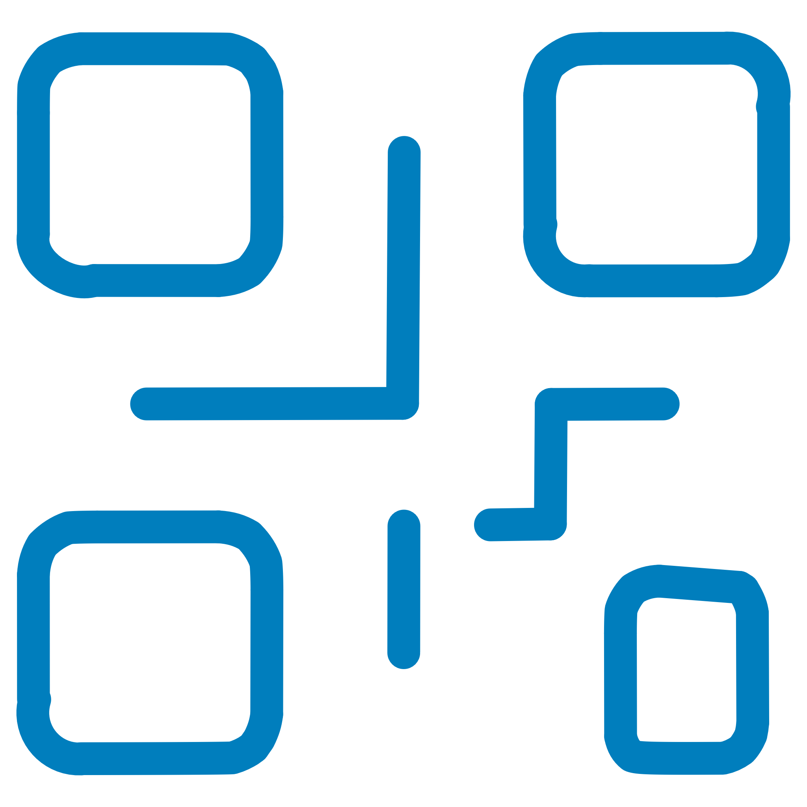

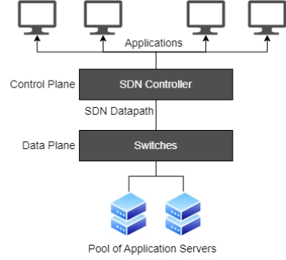



Software-Defined Networking Fundamentals
Core SDN Architecture
Control Plane — The brain of the network, making intelligent routing decisions based on global network visibility
Dynamic Programmability
Data Plane — High-speed packet forwarding layer that executes decisions
from the control plane
Network behavior can be modified through software without touching
physical infrastructure
Network behavior is controlled entirely through software, enabling unprecedented flexibility and automation.
Centralized Control
Single point of intelligence with complete network visibility enables coordinated decision-making across all devices
Automation & Consistency
Policies applied uniformly across the entire network, eliminating configuration drift and human error
Faster Innovation
New features deployed via software updates rather than hardware refresh cycles
Vendor Neutrality
Open standards like OpenFlow enable multi-vendor interoperability and reduce lock-in

Slide 5
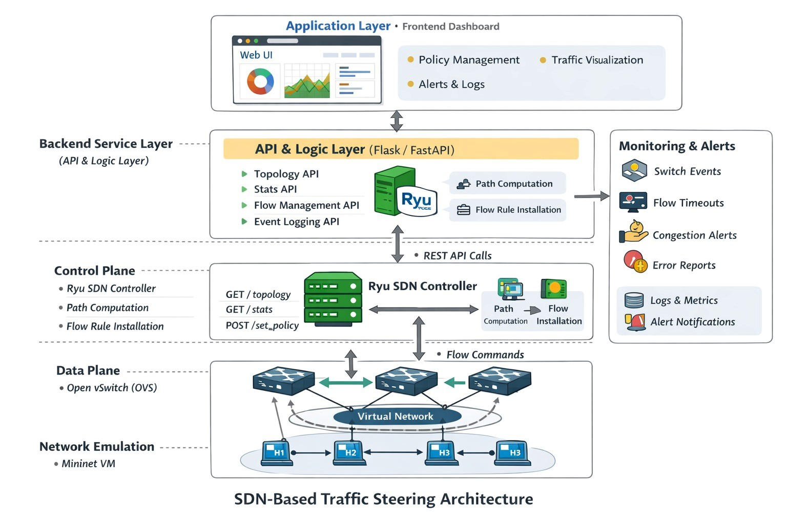




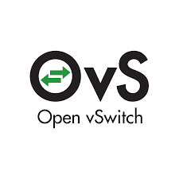

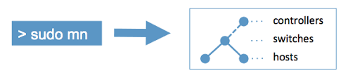


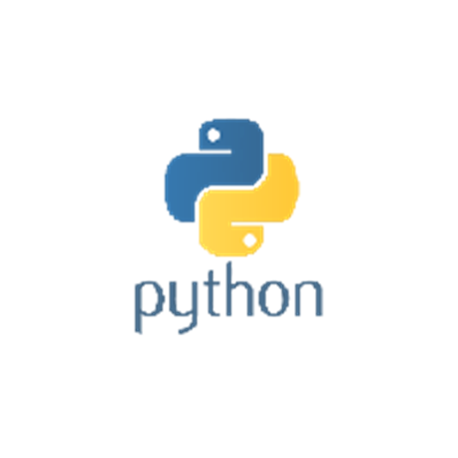

System Components & Architecture Model
Mininet VM
OVS Data Plane
Ryu Control Plane
OpenFlow Protocol
Logical Separation of Concerns
Data Plane focuses exclusively on fast, efficient packet forwarding at line rate speeds
Control Plane provides centralized intelligence, global visibility, and sophisticated decision-making algorithms
This architectural separation enables independent scaling and evolution
of control logic and forwarding capacity, a key advantage over traditional integrated network devices.

Slide 6
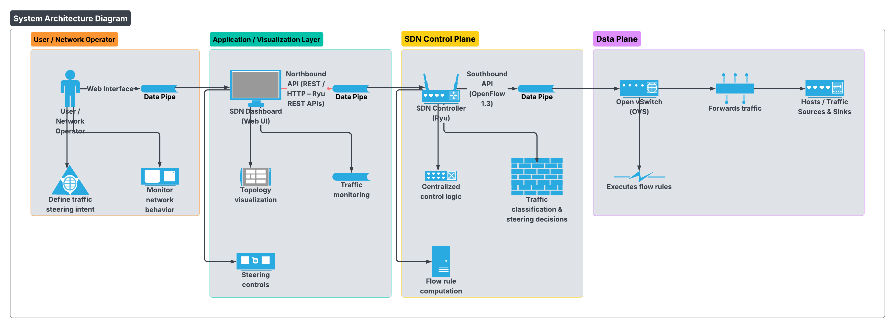


System Architecture
Centralized Control
Programmable Forwarding
Policy-Driven Steering
Single source of truth for network state and policy enforcement
Flow rules dynamically installed based on application requirements
Traffic routing determined by business logic rather than static configuration
Web UI Dashboard
REST API Layer
Backend Service
Ryu Controller
OVS Switches
Network Traffic

Slide 7

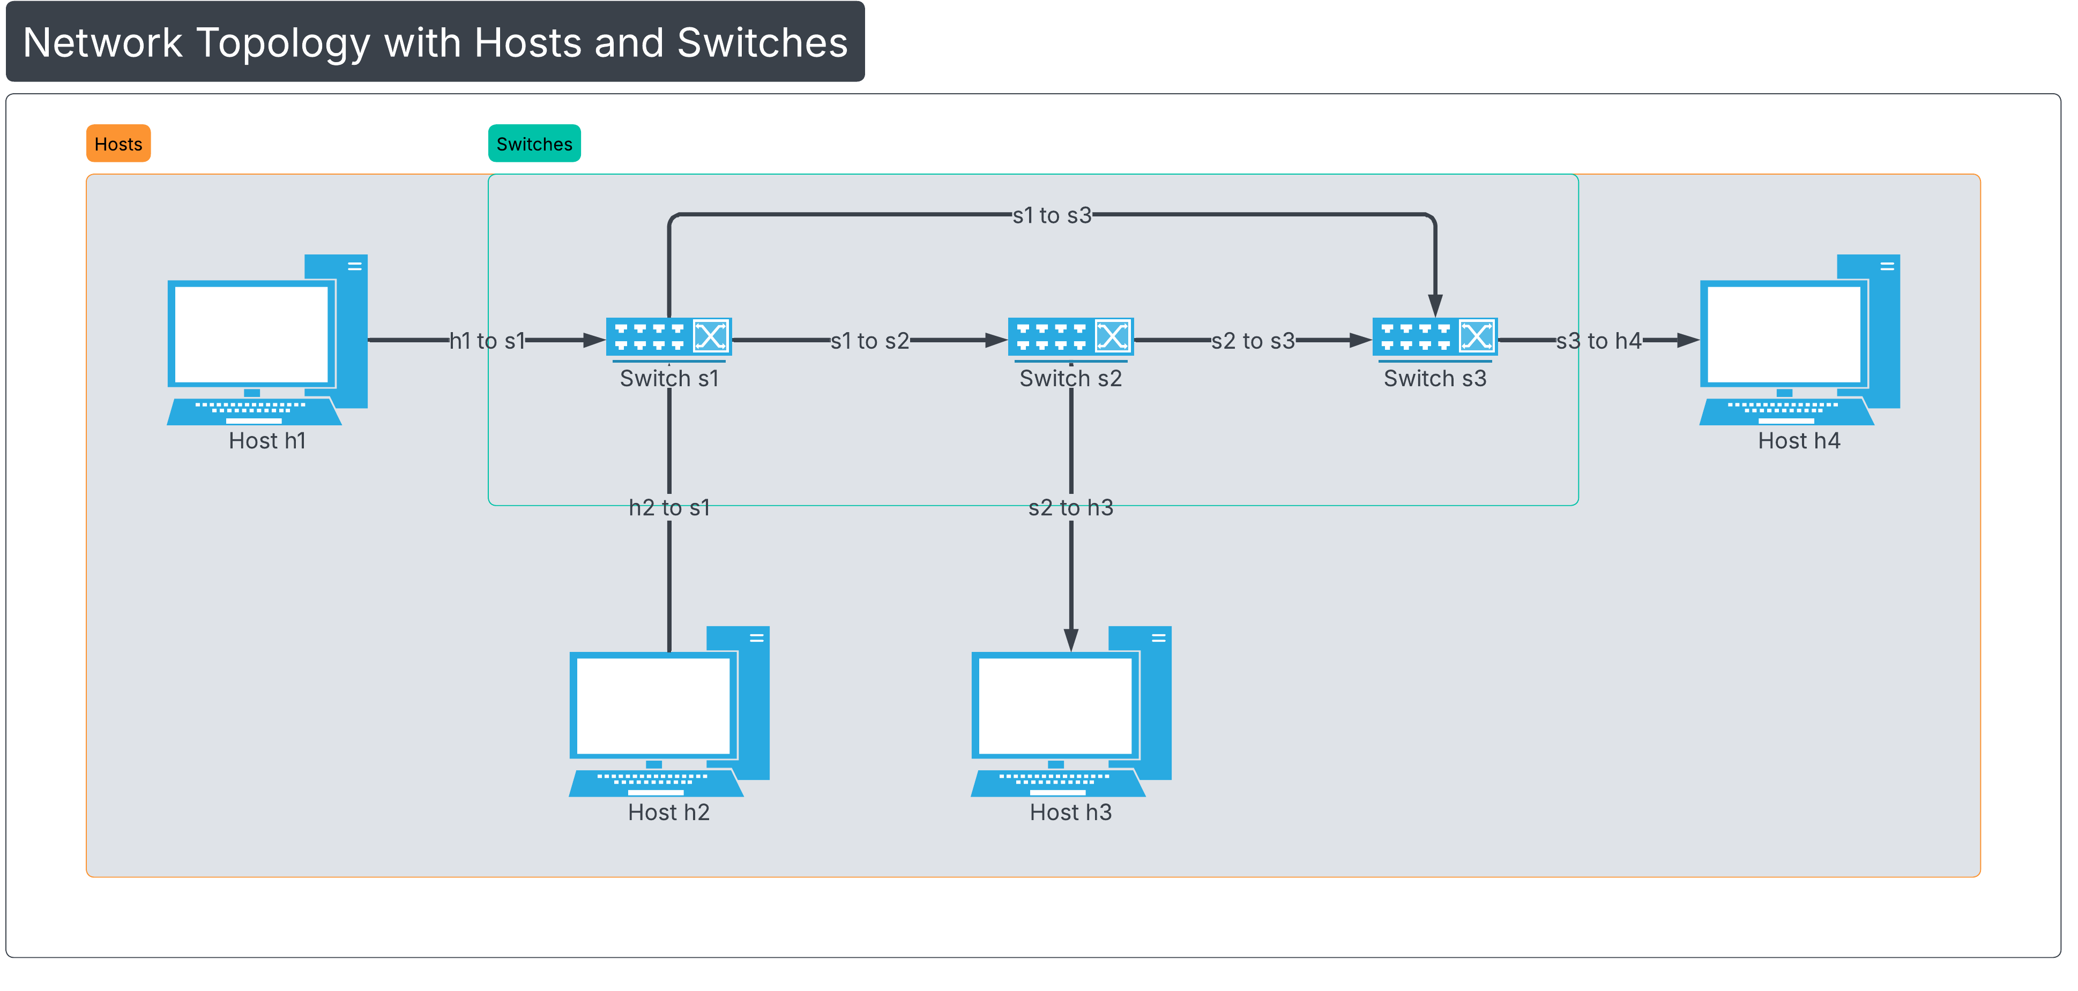
Application Workflow & Interaction Model
Understanding how packets flow through the SDN system reveals the power of centralized control and programmable networking.
01
02
Initial Connection
Topology Discovery
OVS switches establish secure OpenFlow connections to the Ryu controller upon startup
Controller discovers network topology using LLDP (Link Layer Discovery Protocol) messages
03
04
Packet-In Event
Path Computation
When new traffic arrives with no matching flow rule, switches send Packet-In to controller
Controller calculates optimal forwarding path based on topology, policies, and current network state
05
06
Flow Installation
Traffic Forwarding
Controller proactively or reactively installs flow rules across relevant switches in the path
Subsequent packets follow programmed paths at line rate without controller involvement
Traffic Steering Intelligence
Routing decisions based on multiple criteria:
Source/Destination IP addresses — Route traffic between specific endpoints
Protocol type (TCP/UDP) — Differentiate handling for reliable vs. unreliable transport
Application traffic patterns — Optimize paths for iperf benchmarks, web traffic, or streaming media
Network conditions — Adapt to congestion, failures, or link utilization

Slide 8

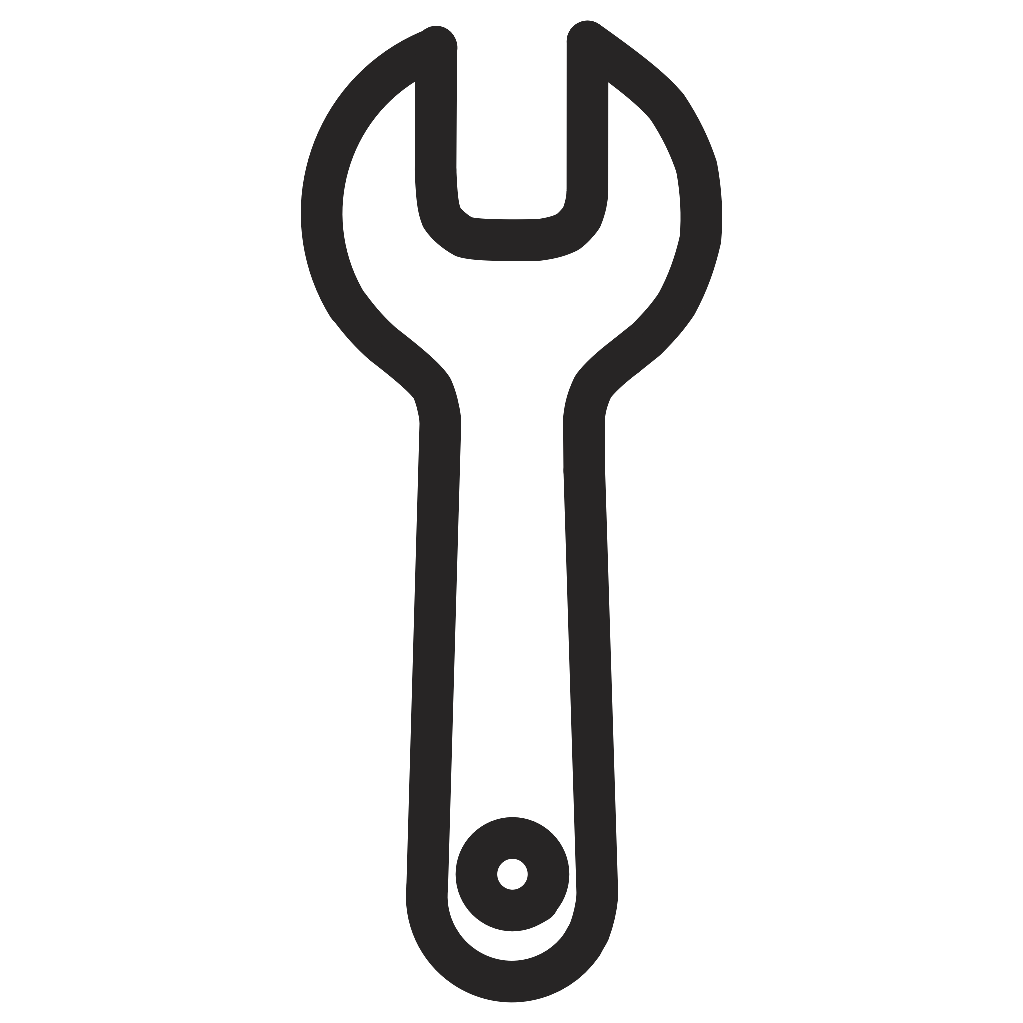
TECHNOLOGY STACK
Setup & Technical Requirements
Hardware Requirements
Software Stack
Network Protocol
Ubuntu Linux (Mininet VM or native installation)
OpenFlow 1.3 as the primary southbound protocol
Laptop or desktop capable of running virtual machines
Open vSwitch virtual switch software
TCP port 6653 for controller communication
Minimum 8 GB RAM recommended for smooth operation
Ryu Controller framework
Support for standard networking protocols (ARP, ICMP, TCP, UDP)
Python 3.x runtime environment
Multi-core processor for adequate performance
Mininet network emulator
20 GB available disk space
1
Environment Setup
Install Ubuntu VM and required software packages
2
Component Configuration
Configure OVS and Ryu controller with proper settings
3
Topology Creation
Design and implement network topology in Mininet
4
Testing & Validation
Verify connectivity and traffic steering functionality

Slide 9


Demonstration & Key Results
Live Demo Workflow
Start Ryu controller with traffic steering application
Launch Mininet topology with multiple hosts and switches
Verify host connectivity using ping tests
Generate traffic flows using iperf bandwidth testing tool
Observe system behavior:
Packet-in events triggering controller logic
Dynamic flow rule installation
Real-time traffic path modifications
Demonstrated Capabilities
End-to-end SDN workflow from packet arrival to intelligent forwarding
Dynamic traffic steering adapting to network conditions in real-time
Centralized control managing multiple switches from a single controller
Key Observations
The system demonstrates dynamic path control, reduced network congestion, and significantly improved response times to traffic
changes validating SDN's advantages over static traditional networking approaches.

Slide 10

Conclusion
Successfully demonstrated SDN-based traffic steering using Open vSwitch and the Ryu Controller.
Achieved dynamic, policy-driven routing with centralized control and real-time adaptability.
Highlighted clear improvements over traditional networks in flexibility, visibility, and operational efficiency.
Demonstrated concepts directly applicable to 5G User Plane, software-driven networking, and modern telecom infrastructure.
Future Enhancements
Extend the solution to support 5G User Plane traffic steering (UPF-level flow handling).
Integrate network slicing and QoS for differentiated wireless services.
Add real-time analytics and monitoring for telecom-scale deployments.
Scale the architecture for cloud-native and edge-based 5G networks.

Slide 11

Thank You
21 Jan, 2026

